Slide 1
Louisa may alcott
11/29/1832 – 3/6/1888

Slide 2
Early Life of Louisa May
Born in Germantown, Pennsylvania
She was the second of four daughters
Her dad – Bronson Alcott – was a major player in the Transcendentalism movement
Bronson raised his daughters in a home that was pro-education and anti-slavery
Emerson, Thoreau, and Hawthorne were all family friends that helped teach her
She and her sisters would put on plays in their home
At one point, her family lived on a Utopian commune near Harvard
She started working at 15 years old in an attempt to help her family get out of poverty
She had crushes on both Emerson and Thoreau when she was a little girl.
She started writing a journal at age 8.

Slide 3
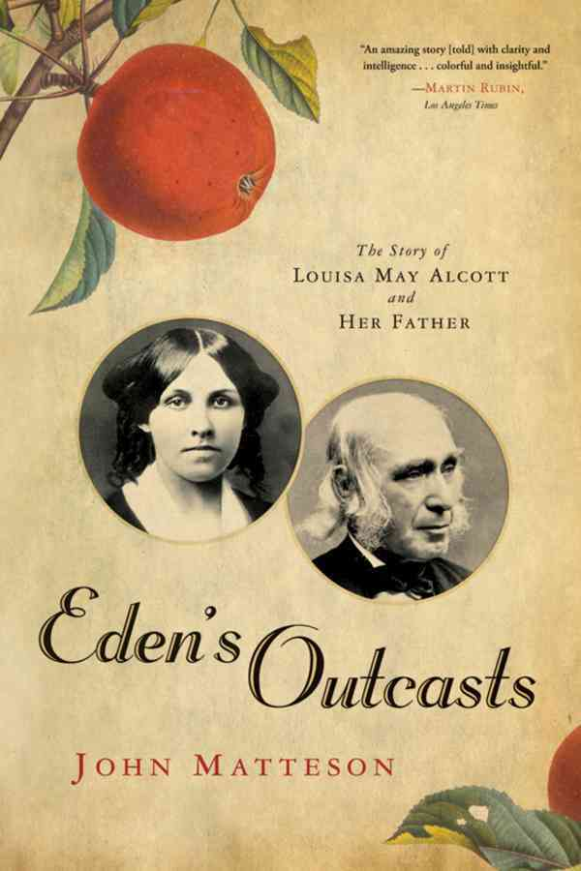
Accomplishments Awards
She wrote Little Women – her most famous work.
She volunteered as a nurse during the Civil War.
Wrote Hospital Sketches, which gave a face to a lot of the soldiers in the war.
Wrote her first novel at age 17.
Although Pulitzer Prizes were not awarded until the 1900s, a biography ABOUT Louisa May Alcott received a Pulitzer Prize in 2008. It was called Eden’s Outcasts.

Slide 4
Character traits
Louisa May Alcott was fiercely independent. She created the character Jo in her likeness. Jo was a tomboy.
Alcott did not like her book Little Women, but she needed money.
When her dad lost money and they had to struggle for food, she was determined to work any job to make money. She taught, wrote, acted, sewed, and was even a household servant.
She had several relationships as a woman, but never married. She wanted to be able to earn and keep her own money, which married women were not allowed to do.
Thought motherhood was incompatible with earning a living.

Slide 5
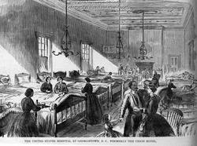
Impact on the world
Involved in the Underground Railroad.
Was a suffragist – in fact, she wrote articles encouraging women to register to vote.
Influenced children as an editor of a children’s magazine
Started a temperance society in Concord, Mass.
Volunteered for the Union Army in the Civil War to do what she could do to eliminate slavery

Slide 6
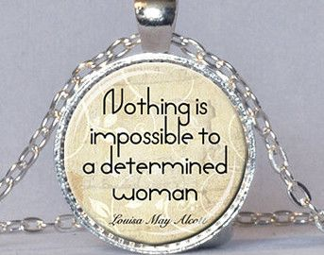
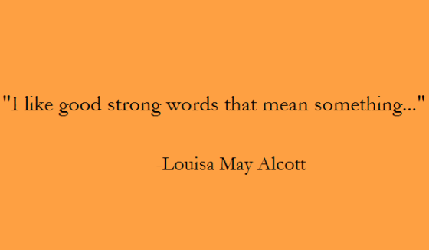
Famous Quotes

Slide 7
Louisa May Alcott
The Beginning of the End:
While working as a nurse during the war, Alcott contracted mercury poisoning and was never the same.
The hospital conditions were terrible, and Alcott was in charge of 40 beds of soldiers suffering from pneumonia, diphtheria, and typhoid.
She wrote about the horrible sights (death) and odors of this hospital.
Her service here is what eventually killed her: She first contracted typhoid pneumonia and was sent home from service. Later, it was believed she was poisoned by the mercury.
She died at age 56, but before her death, she legally adopted her nephew so that her sister, nephews, and niece could receive the royalties from her books.

Slide 8
Life lesson:
Louisa May Alcott was someone who could pursue her personal goals, which included wealth, yet still remain true to her beliefs. She was hardworking and took on any and every job she could to support her family; as she grew older, she remained single so she could keep her earnings.
She put her life at risk to help abolish slavery, she used her voice to promote women’s rights, and she used her time to help raise her niece and support her family at the end of her life.

Slide 9
Works Cited
“Going to War: Louisa May Alcott’s Experience as a Civil War Nurse.”
Lmacivilwar.weebly.com. Web. 16 January 2018
“Louisa May Alcott”. United States History. U-s-history.com Web. 16
January 2018.
“Louisa May Alcott: The Woman Behind Little Women.” Nancy Porter Film.
2018. Web. 16 January 2018.
Smith, Bonnie Hurd. “Louisa May Alcott”, Boston Women’s
Heritage Trail. Web. 16 January 2018

